Slide 1

Hive Assignment
-BY SAADIYA

Slide 2
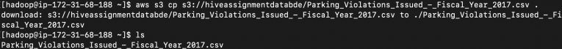
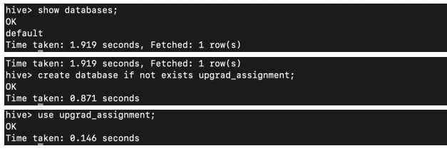
1. Downloading data in Hadoop
CODE :
aws s3 cp s3://hiveassignmentdatabde/Parking_Violations_Issued_-_Fiscal_Year_2017.csv
2. Showing list of databases and creating a new database for project
CODE :
show databases; create database if not exists upgrad_assignment; use upgrad_assignment;

Slide 3
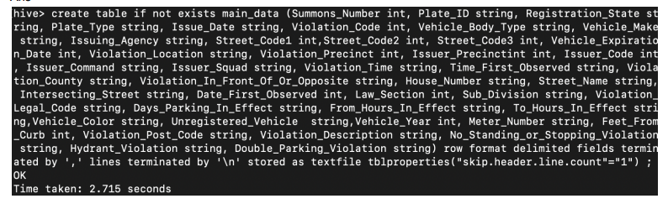
3.Creating a table
CODE :
create table if not exists main_data
(Summons_Number int, Plate_ID string, Registration_State string, Plate_Type string, Issue_Date string, Violation_Code int, Vehicle_Body_Type string, Vehicle_Make string, Issuing_Agency string, Street_Code1 int, Street_Code2 int, Street_Code3 int, Vehicle_Expiration_Date int, Violation_Location string, Violation_Precinct int, Issuer_Precinctint int, Issuer_Code int, Issuer_Command string, Issuer_Squad string, Violation_Time string, Time_First_Observed string, Violation_County string, Violation_In_Front_Of_Or_Opposite string, House_Number string, Street_Name string, Intersecting_Street string, Date_First_Observed int, Law_Section int, Sub_Division string, Violation_Legal_Code string, Days_Parking_In_Effect string, From_Hours_In_Effect string, To_Hours_In_Effect string,Vehicle_Color string, Unregistered_Vehicle string,Vehicle_Year int, Meter_Number string, Feet_From_Curb int, Violation_Post_Code string, Violation_Description string, No_Standing_or_Stopping_Violation string, Hydrant_Violation string, Double_Parking_Violation string) row format delimited fields terminated by ',' lines terminated by '\n' stored as textfile tblproperties("skip.header.line.count"="1") ;

Slide 4
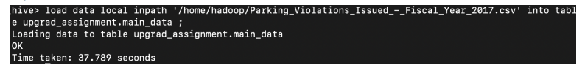
4. Loading data into the table
CODE :
load data local inpath '/home/hadoop/Parking_Violations_Issued_-_Fiscal_Year_2017.csv' into table upgrad_assignment.main_data ;
5. Creating two new fields to convert date to date time and violation time to hour of the day.
CODE :
ALTER TABLE main_data ADD COLUMNS (issue_date_date timestamp);
ALTER TABLE main_data ADD COLUMNS (hour_of_day int);
insert into main_data select Summons_Number, Plate_ID, Registration_State, Plate_Type, Issue_Date, Violation_Code, Vehicle_Body_Type, Vehicle_Make, Issuing_Agency, Street_Code1, Street_Code2, Street_Code3, Vehicle_Expiration_Date, Violation_Location, Violation_Precinct, Issuer_Precinctint, Issuer_Code, Issuer_Command, Issuer_Squad, Violation_Time, Time_First_Observed, Violation_County, Violation_In_Front_Of_Or_Opposite, House_Number, Street_Name, Intersecting_Street, Date_First_Observed, Law_Section, Sub_Division, Violation_Legal_Code, Days_Parking_In_Effect, From_Hours_In_Effect, To_Hours_In_Effect, Vehicle_Color, Unregistered_Vehicle, Vehicle_Year, Meter_Number, Feet_From_Curb, Violation_Post_Code, Violation_Description, No_Standing_or_Stopping_Violation, Hydrant_Violation, Double_Parking_Violation, from_unixtime(unix_timestamp(main_data.issue_date, "MM/dd/yyyy")), int(substr(violation_time,0,2)) + case when substr(violation_time,-1)=='A' then 0 else 12 end Violation_Time_Hour from main_data;

Slide 5
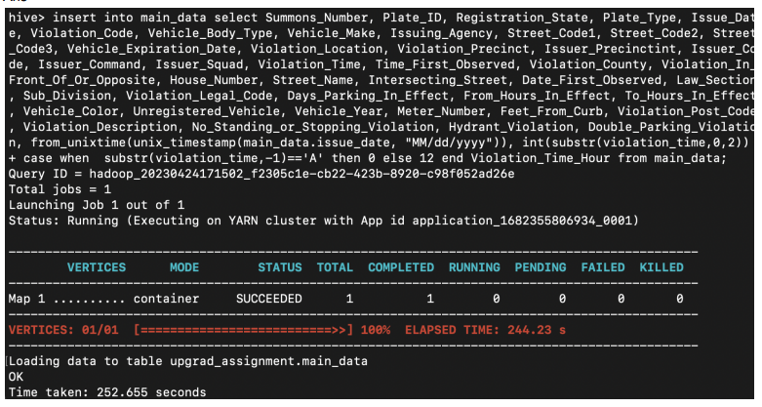
5. Creating two new fields to convert date to date time and violation time to hour of the day.
OUTPUT

Slide 6
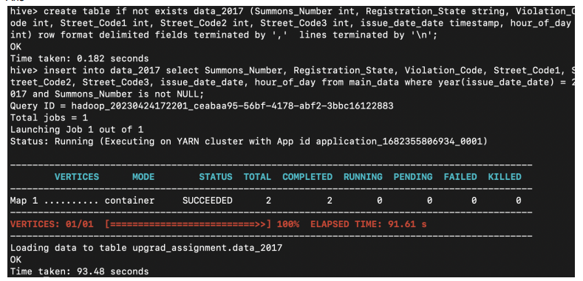
6. Creating a new table data_2017 for data containing only 2017 data and inserting relevant data:
CODE :
create table if not exists data_2017 (Summons_Number int, Registration_State string, Violation_Code int, Street_Code1 int, Street_Code2 int, Street_Code3 int, issue_date_date timestamp, hour_of_day int) row format delimited fields terminated by ',' lines terminated by '\n’;
insert into data_2017 select Summons_Number, Registration_State, Violation_Code, Street_Code1, Street_Code2, Street_Code3, issue_date_date, hour_of_day from main_data where year(issue_date_date) = 2017 and Summons_Number is not NULL;

Slide 7
Part -1

Slide 8
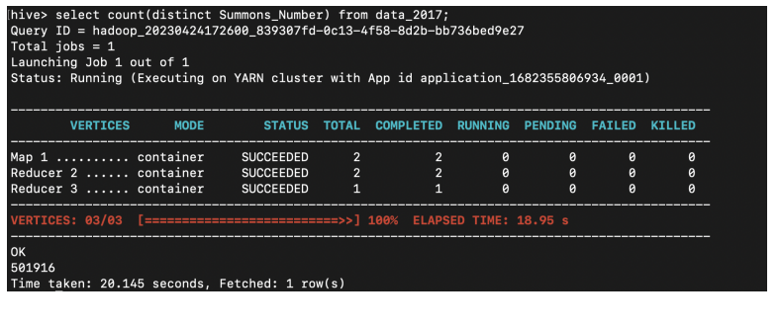
1. Find the total number of tickets for the year.
CODE :
select count(distinct Summons_Number) from data_2017;

Slide 9
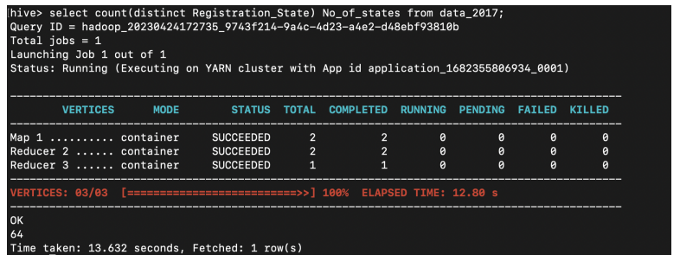
2. Find out the total number of states to which the cars with tickets belong.
CODE :
select count(distinct Registration_State) No_of_states from data_2017;
select distinct Registration_State from data_2017;

Slide 10
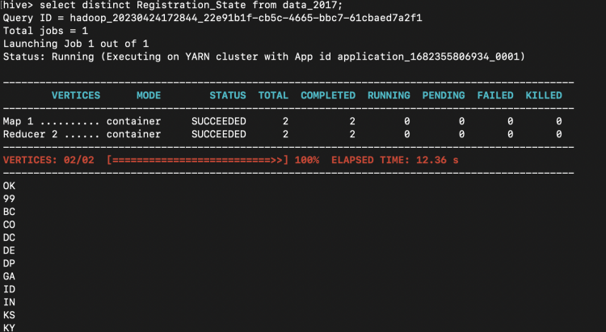
2. Find out the total number of states to which the cars with tickets belong.
Output :

Slide 11
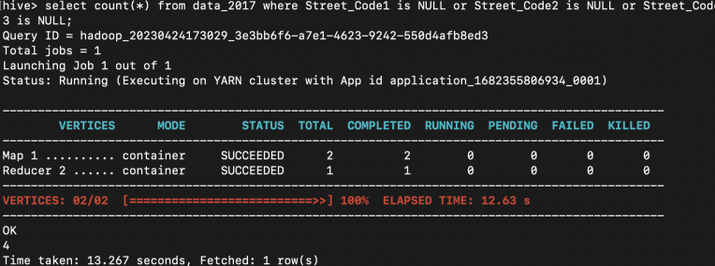
3.Some parking tickets don’t have addresses on them, which is a cause for concern. Find out the number of such tickets which have no addresses.
CODE :
select count(*)
from data_2017
where Street_Code1 is NULL or Street_Code2 is NULL or Street_Code3 is NULL;

Slide 12
3.Some parking tickets don’t have addresses on them, which is a cause for concern. Find out the number of such tickets which have no addresses.
CODE :
select count(*)
from data_2017
where Street_Code1 is NULL or Street_Code2 is NULL or Street_Code3 is NULL;

Slide 13
DATA PREPARATION

Slide 14
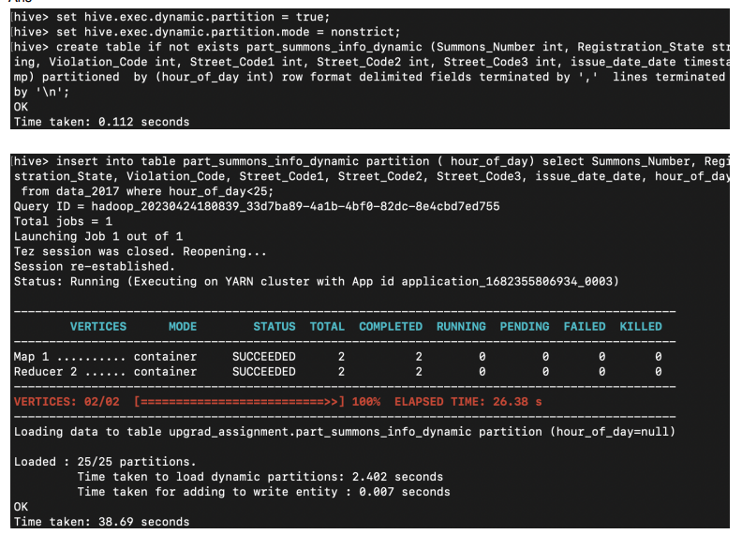
Create dynamic partition over hour_of_day for efficient query
CODE :
set hive.exec.dynamic.partition = true;
set hive.exec.dynamic.partition.mode = nonstrict;
create table if not exists part_summons_info_dynamic (Summons_Number int, Registration_State string, Violation_Code int, Street_Code1 int, Street_Code2 int, Street_Code3 int, issue_date_date timestamp) partitioned by (hour_of_day int) row format delimited fields terminated by ',' lines terminated by '\n’;
insert into table part_summons_info_dynamic partition ( hour_of_day) select Summons_Number, Registration_State, Violation_Code, Street_Code1, Street_Code2, Street_Code3, issue_date_date, hour_of_day from data_2017 where hour_of_day<24;

Slide 15
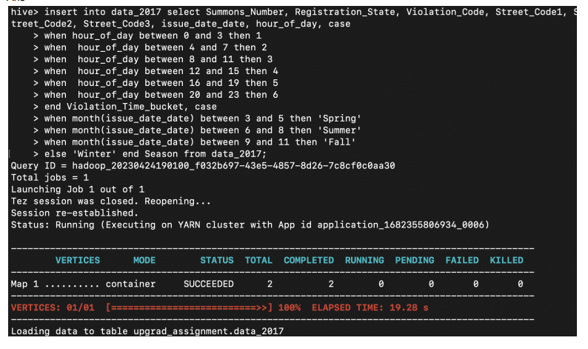
We need some additional columns like dividing time into 6 buckets, and date into season:
CODE :
ALTER TABLE data_2017 ADD COLUMNS (Violation_Time_bucket int);
ALTER TABLE data_2017 ADD COLUMNS (Season string); (Adding data) insert into data_2017 select Summons_Number, Registration_State, Violation_Code, Street_Code1, Street_Code2, Street_Code3, issue_date_date, hour_of_day, case when hour_of_day between 0 and 3 then 1 when hour_of_day between 4 and 7 then 2 when hour_of_day between 8 and 11 then 3 when hour_of_day between 12 and 15 then 4 when hour_of_day between 16 and 19 then 5 when hour_of_day between 20 and 23 then 6 end Violation_Time_bucket, case when month(issue_date_date) between 3 and 5 then 'Spring' when month(issue_date_date) between 6 and 8 then 'Summer' when month(issue_date_date) between 9 and 11 then 'Fall' else 'Winter' end Season from data_2017;

Slide 16
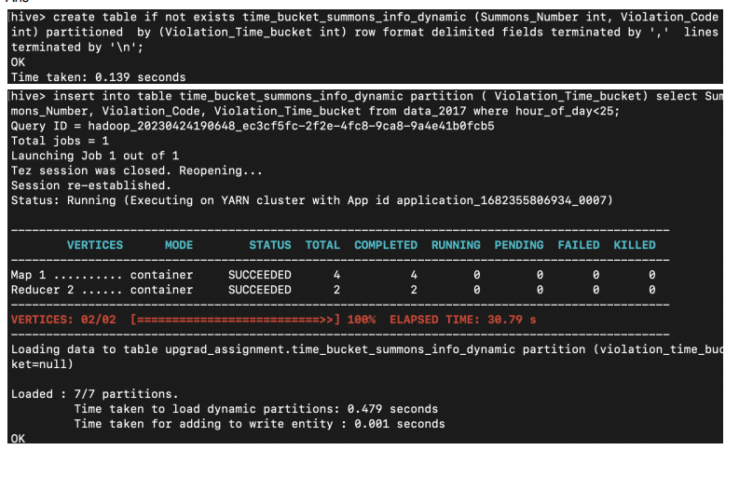
Creating a dynamic partition for Violation_Time_bucket, to fasten the hive query:
CODE :
create table if not exists time_bucket_summons_info_dynamic (Summons_Number int, Violation_Code int) partitioned by (Violation_Time_bucket int) row format delimited fields terminated by ',' lines terminated by '\n'; insert into table time_bucket_summons_info_dynamic partition ( Violation_Time_bucket) select Summons_Number, Violation_Code, Violation_Time_bucket from data_2017 where hour_of_day<25;

Slide 17
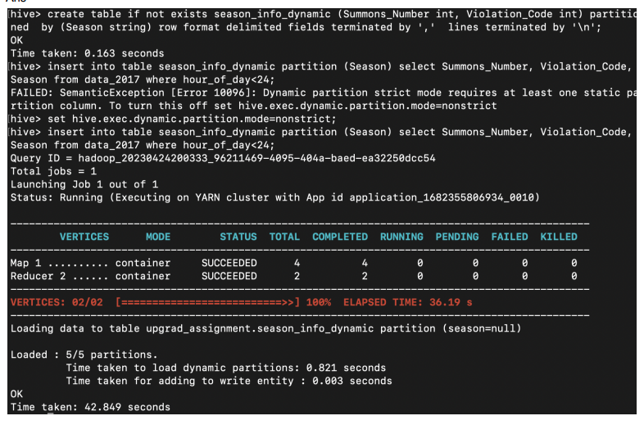
Season variable is already created in the 3rd point. Creating a dynamic partition over season for faster query.
CODE :
(Creating season dynamic partition for faster query) create table if not exists season_info_dynamic (Summons_Number int, Violation_Code int) partitioned by (Season string) row format delimited fields terminated by ',' lines terminated by '\n'; (Inserting Data) insert into table season_info_dynamic partition (Season) select Summons_Number, Violation_Code, Season from data_2017 where hour_of_day<24;

Slide 18
PART - 2

Slide 19
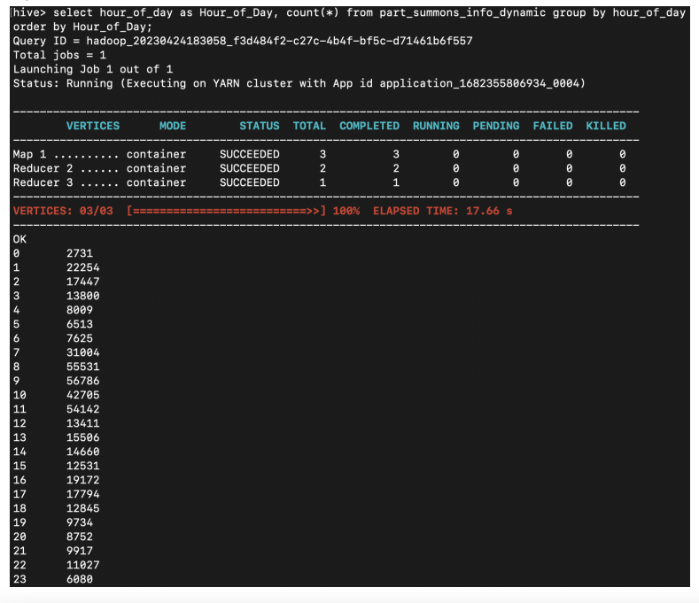
1. Find out the frequency of parking violations across different times of the day: The Violation Time field is specified in a strange format. Find a way to make this into a time attribute that you can use to divide into groups
CODE :
select hour_of_day as Hour_of_Day, count(*) from part_summons_info_dynamic group by hour_of_day order by Hour_of_Day;

Slide 20
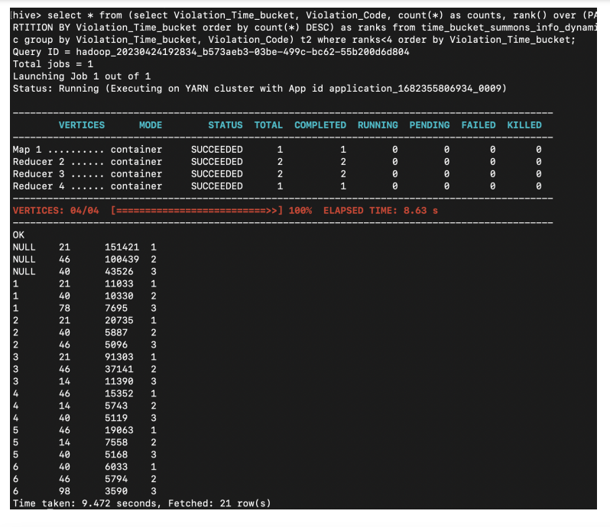
2. Divide 24 hours into six equal discrete bins of time. The intervals you choose are at your discretion. For each of these groups, find the 3 most commonly occurring violations.
CODE :
select * from (select Violation_Time_bucket, Violation_Code, count(*) as counts, rank() over (PARTITION BY Violation_Time_bucket order by count(*) DESC) as ranks from time_bucket_summons_info_dynamic group by Violation_Time_bucket, Violation_Code) t2 where ranks

Slide 21
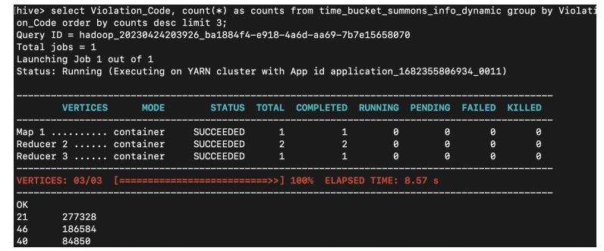
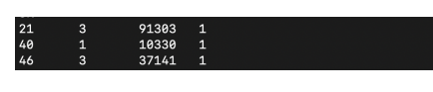
3.Now, try another direction. For the 3 most commonly occurring violation codes, find the most common times of day
CODE :
select Violation_Code, count(*) as counts from time_bucket_summons_info_dynamic group by Violation_Code order by counts desc limit 3;
select * from (select Violation_Code, Violation_Time_bucket, count(*), rank() over (PARTITION BY Violation_Code order by count(*) DESC) as ranks from time_bucket_summons_info_dynamic group by Violation_Code, Violation_Time_bucket having Violation_Code in (21, 46, 40) order by Violation_Code) t2 where ranks = 1;
For 21 violation code - violation time buckets - 3 (9 to 11)
For 40 violation code - violation time buckets - 1 (0 to 3)
For 46 violation code - violation time buckets - 3 (9 to 11)

Slide 22
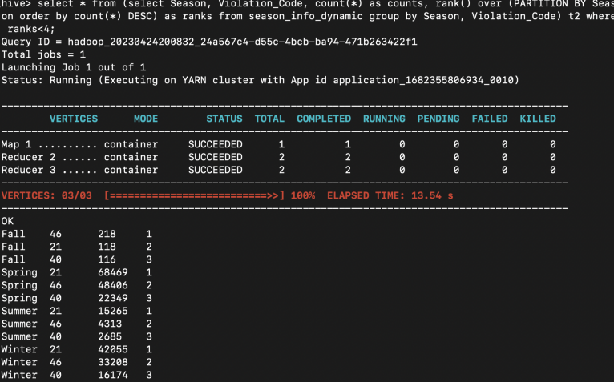
4. Find the 3 most common violations for each of these seasons
CODE :
select * from (select Season, Violation_Code, count(*) as counts, rank() over (PARTITION BY Season order by count(*) DESC) as ranks from season_info_dynamic group by Season, Violation_Code) t2 where ranks<4;

Slide 23
THANK YOU

